Slide 1

Data Pre-processing
A Strategic Imperative for Maximizing Data Warehousing Value
Group Assignment
Course:
Data Curation and Management
Submitted to:
.
Date:
Team Members
Team Member 1
Team Member 2
Team Member 3
Team Member 4
Master's Program in Data Science
Made with Genspark
University Name

Slide 2
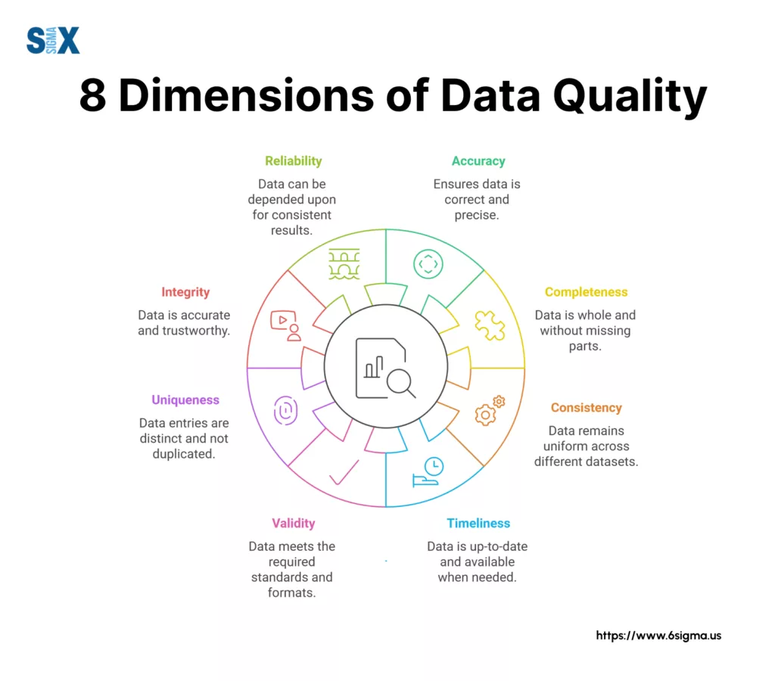
Executive Summary & Overview
Data Quality Challenges
What is Data Pre-processing?
The process of cleaning, converting, and organizing raw data to prepare it for analytics, machine learning, and AI applications in data warehousing environments.
Why is it Critical?
Ensures accurate insights and sound decision-making. Neglecting pre-processing leads to erroneous forecasts, skewed outcomes, wasteful processes, and diminished trust in data.
Key Strategic Recommendations
Implement a phased approach to data quality management, invest in automation, establish clear governance, and foster a data-driven culture through stakeholder engagement.
8 Core Dimensions of Data Quality
Source: Six Sigma
Key Insight
Organizations that implement rigorous data pre-processing gain a significant competitive advantage through more accurate insights and faster time-to-decision.

Slide 3





Defining the Problem: Business Impact of Poor Data Pre-processing
Cost of Poor Data Quality
Impaired Decision-Making
Inaccurate predictions, biased analysis, and poor business judgments arise from bad data, wasting resources and missing opportunities.
Operational Inefficiencies & Financial Losses
Unprocessed data results in failed projects, ineffective algorithms, and higher computing costs, leading to substantial negative financial impact.
12.9%
Revenue Loss
70%
More Project Time
35%
Lower User Trust
Erosion of Trust & Compliance Risks
Inaccurate data undermines analytics trust, discourages adoption, and may result in non-compliance with regulations (CCPA, GDPR), risking penalties and reputational damage.
Source: Gartner Research, 2024
"Poor data quality costs organizations an average of
$12.9 million annually. Data preprocessing is not optional—it's a business imperative."
— Harvard Business Review
Key Takeaway
Organizations that neglect data pre-processing face cascading negative effects that impact not only their analytics capabilities but their entire business performance and competitive position.

Slide 4






Data Quality Issues & Challenges
Additional Data Quality Challenges
Modern organizations face numerous data quality challenges that impact analytics performance and business decisions. These include:
Stale or Outdated Data
Information that is no longer relevant or up-to-date, leading to historical rather than current insights.
Missing Data
Values absent due to nonresponse or collection failures, creating gaps in analysis.
Irrelevant Data
Information that doesn't advance analytical goals, creating noise that obscures meaningful patterns.
Inconsistent Data
Discrepancies in values or formats between sources, leading to contradictory insights.
Unstructured Data
Information lacking predefined format (text, images), requiring specialized processing techniques.
Duplicate Data
Same information recorded multiple times, skewing frequencies and statistical measures.
Outliers
Data points that deviate significantly from the norm, potentially distorting analysis results.
Impact on Business
Research shows that data scientists spend up to 80% of their time on data preparation and cleaning activities rather than on generating insights, representing significant operational inefficiency.
8 Core Dimensions of Data Quality
Data Pre-processing: A Strategic Imperative
Made with Genspark
4

Slide 5

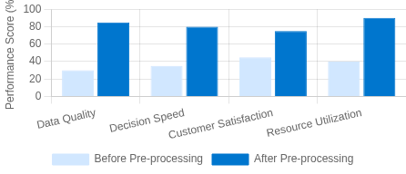




Strategic Benefits & ROI of Data Pre- processing
Improved Data Quality & Reliability
Ensures data is accurate, consistent, and reliable, serving as the foundation for insights that can be trusted.
Quantifiable Benefits
Better Model Performance
Clean data helps AI/ML models make more accurate predictions, run more efficiently, and avoid problems like overfitting.
Operational Efficiency & Resource Optimization
Streamlines data pipelines, lowers computational requirements, and frees up resources for key activities.
Deeper Insights & Competitive Advantage
High-quality data enables better business intelligence, improving decision- making and customer satisfaction.
Key Performance Metrics
92%
Model Accuracy
68%
Faster Insights
42%
Cost Reduction
ROI Insight
Organizations investing in data pre-processing report 4-6x ROI through increased productivity, reduced error costs, and faster time-to-insight.
Data Pre-processing: A Strategic Imperative
Made with Genspark
5

Slide 6



Implementation Roadmap: Phased Approach
Phase 1: Assessment & Strategic Alignment
Define business objectives and KPIs aligned with strategic goals
Audit existing data infrastructure and identify data silos
Select appropriate architecture (cloud/hybrid)
Timeline: 4-6 weeks
Phase 2: Design & Solution Architecture
Create scalable data warehouse schema
Design pre-processing techniques (imputation, scaling)
Develop data ingestion pipelines and integrate AI automation
Timeline: 6-8 weeks
Phase 3: Implementation & Integration
Establish ETL/ELT workflows for data warehousing
Create data governance frameworks and security policies
Connect to BI tools (Tableau, Power BI) for analytics
Timeline: 8-12 weeks
Phase 4: Continuous Improvement
Monitor data quality and pipeline performance
Implement feedback loops and iterative refinement
Develop cost management strategies
Timeline: Ongoing
Implementation Timeline & Stakeholders
Phase 1 4-6 Weeks | Phase 2 6-8 Weeks | Phase 3 8-12 Weeks | Phase 4 Ongoing
Executives
Data Architects
Data Engineers
Business
Users
*Color intensity indicates level of involvement in each phase
Implementation Best Practice
Successful implementation requires cross-functional collaboration and clearly defined ownership at each phase. Begin with a pilot project to demonstrate value before full-scale deployment.
Data Pre-processing: A Strategic Imperative
Made with Genspark
6

Slide 7



Stakeholder Engagement Strategies
Stakeholder Influence-Interest Matrix
Identifying Stakeholders & Understanding Needs
Identify all key stakeholders (executives, managers, analysts, IT, compliance) and understand their specific requirements, priorities, and knowledge levels to tailor communication effectively.
Effective Communication Framework
Use clear, jargon-free language. Leverage visualizations and real-world examples to simplify complex concepts. Focus on business outcomes rather than technical details to build understanding and trust.
Cultivating Collaboration & Buy-in
Form cross-functional teams across departments. Conduct regular interactions, workshops, and tailored training. Define clear roles and responsibilities to ensure shared accountability and ownership.
 | Low Interest | High Interest
High Influence | Keep Satisfied Executive Leadership | Key Players Business Unit Heads IT Leadership
Medium Influence | Monitor Compliance External Partners | Keep Informed Data Architects Data Engineers
Low Influence | Minimal Effort General Staff | Show Consideration Business Analysts End Users
Communication Best Practices
Be transparent about data quality issues. Encourage two-way feedback loops. Provide regular updates on progress and demonstrate early wins to build momentum and trust throughout the organization.
Tailoring Messages by Audience
Executives
ROI, competitive
IT Teams
Implementation
Business Users
Usability,
advantage, strategic alignment
details, technical requirements, timeline
benefits to daily work, data insights
Data Pre-processing: A Strategic Imperative
Made with Genspark
7

Slide 8





Best Practices & Recommendations
Implementation Framework
Create a Data Quality Task Force
Form a cross-functional team of data engineers, business analysts, and domain experts to champion data quality initiatives and oversee implementation.
1. Assess & Prioritize
Evaluate current data quality and identify high-impact areas for immediate action.
2. Build Infrastructure
Implement tooling, establish workflows, and create monitoring capabilities.
Conduct Comprehensive Data Audits
Regularly assess data quality using defined metrics, identify issues and their root causes, and establish baselines for measuring improvement.
3. Train & Collaborate
Develop skills and foster cross-departmental cooperation for data quality.
Invest in Automation & AI Technologies
Leverage AI-powered tools for data cleaning, anomaly detection, and transformation to ensure speedy, accurate, and scalable pre-processing.
4. Measure & Iterate
Track progress against KPIs and continuously refine approaches.
Integrate Data Governance
Embed quality standards and rules into daily operations with clear roles, responsibilities, and accountability for data stewardship.
5. Scale & Standardize
Expand successful practices across the organization and formalize into standards.
Key Insight
Data pre-processing should be viewed as an ongoing strategic investment rather than a one-time project. Organizations that build data quality into their culture and operations consistently outperform competitors.
Success Rate by Approach
27%
58%
89%
Ad-hoc Approach
Project-based Approach
Strategic Approach
Data Pre-processing: A Strategic Imperative
Made with Genspark
9

Slide 9



Case Studies & Real-World Examples
Amazon: Personalized Recommendation Engine
Implemented advanced data preprocessing pipeline to clean and transform user behavior data. Resulted in 35% improved recommendation accuracy and 29% increase in cross-selling revenue.
Key technique: Automated data validation and enrichment with machine learning- driven anomaly detection.
Implementation Success Metrics
68%
Average Time Savings in Data Preparation
41%
Improved Model Accuracy
3.7x
Average ROI on Investment
73%
Reduction in Data Quality Issues
Mayo Clinic: Healthcare Analytics
Deployed comprehensive data quality framework for patient data preprocessing. Improved diagnostic model accuracy by 27% and reduced data preparation time by 65%.
Key technique: Standardized ETL processes with automated data cleaning rules for medical terminology.
Based on McKinsey & Company research across 150+ enterprise implementations
Capital One: Financial Fraud Detection
Implemented real-time data preprocessing for transaction data. Reduced false positives by 42% while improving fraud detection rate by 37%.
Key technique: Feature engineering pipeline with automated handling of missing and inconsistent values.
Lessons Learned
Start small: Begin with high-impact use cases to demonstrate value
Automate early: Manual preprocessing doesn't scale effectively
Focus on feedback: Create loops for continuous improvement Engage stakeholders: Business input is critical for relevant
preprocessing
Common Success Factors
Cross-functional teams with business and technical expertise Phased implementation approach with measurable milestones Continuous improvement culture with feedback loops Integration of data governance throughout the process
Data Pre-processing: A Strategic Imperative
Made with Genspark
10

Slide 10

Conclusion & Next Steps
Key Takeaways
Data pre-processing is a strategic necessity, not an optional step. It ensures
Roadmap to Success
accurate insights, efficient operations, and ultimately provides a competitive edge in today's data-driven business landscape.
1
Establish Baseline Measurements
Document current data quality metrics
Recommended Actions
Form a dedicated Data Quality Task Force, conduct comprehensive data audits, invest in automation, implement the phased roadmap, and prioritize stakeholder engagement to drive adoption across the organization.
Implement Pre-processing Framework
Deploy tools and establish protocols
2
3
Integrate with Data Governance
Align with broader data strategy
Future Considerations
Stay ahead of emerging trends including automated pre-processing, federated learning, real-time data quality monitoring, and prepare for decentralized data models like data mesh architecture.
4
Monitor & Continuously Improve
Establish feedback loops and KPIs
Critical Success Factor
Data quality is not a one-time initiative but an ongoing process that requires continuous monitoring, iterative refinement, and organizational commitment.

Slide 11

Questions & Discussion
Thank You for Your Attention!
We appreciate your time and engagement with our presentation on data pre-processing strategies.
We welcome your questions, insights, and discussion points.

